Slide 1


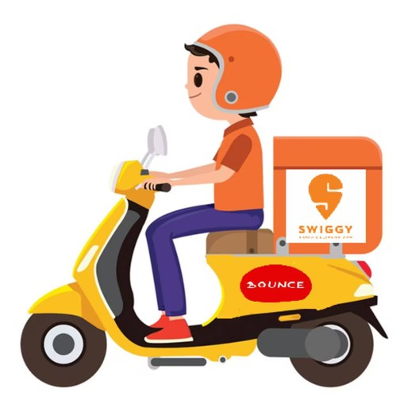


Deep-Dive Analysis
Presented By Vishwas Kandakatla

Slide 2



Problem Statement
Swiggy is one of the largest food delivery platforms in India, which aims to make more informed business decisions and seeks deeper insights on its large SQL dataset. This aims to use powerful SQL queries and complex joins to draw comprehensive data analyses that can help in strategic decision-making. The sought-after insights will involve demographic information about clients, restaurant performance, patterns regarding the timing of orders, and efficiency in delivery.

Slide 3



Methodology Used in the Analysis
Data Source: Kaggle.
Tool: MySQL for Querying data from Database

Slide 4

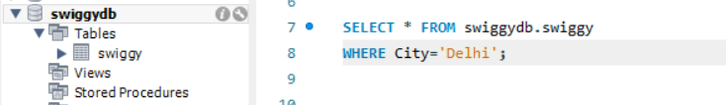

Problem: Display all customers who live in 'Delhi'.
MySql Query for Above problem:

Slide 5
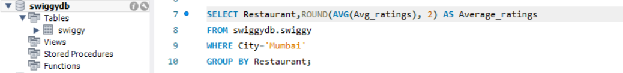
Problem: Find the average rating of all restaurants in 'Mumbai'
MySql Query for Above problem:

Slide 6
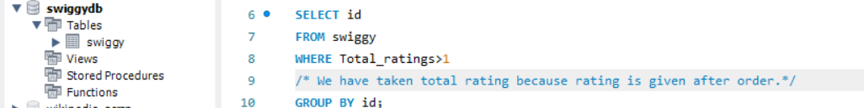
Problem:List all customers who have placed at least one order.
MySql Query for Above problem:

Slide 7

Problem:Display the total number of orders placed by each customer.
MySql Query for Above problem:

Slide 8
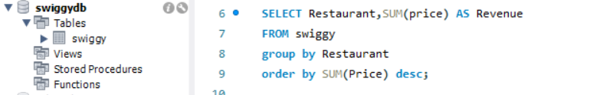
Problem: Find the total revenue generated by each restaurant
MySql Query for Above problem:

Slide 9
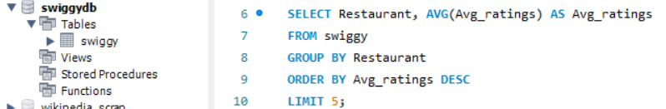
Problem:Find the top 5 restaurants with the highest average rating.
MySql Query for Above problem:

Slide 10
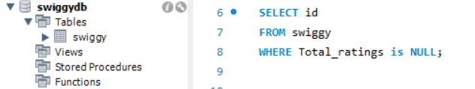
Problem: Display all customers who have never placed an order
MySql Query for Above problem:

Slide 11
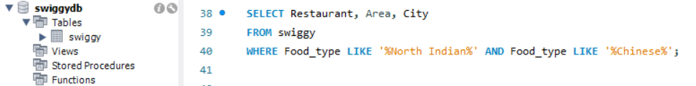
Problem: Find all restaurants that offer both North Indian and Chinese cuisine.
MySql Query for Above problem:

Slide 12

Problem: Find the total number of restaurants in each city.
MySql Query for Above problem:

Slide 13

Problem: Find the average meal price for each area.
MySql Query for Above problem:

Slide 14
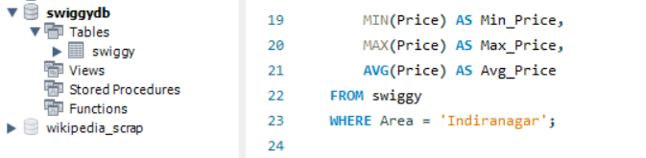
Problem: Find the minimum, maximum, and average price of meals for restaurants in the Indiranagar area.
MySql Query for Above problem:

Slide 15
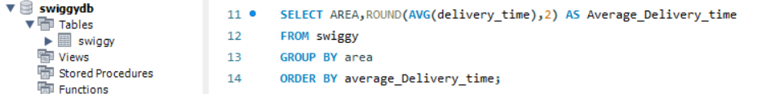
Problem: Find the Delivery Time Analysis by Area
MySql Query for Above problem:

Slide 16


Conclusion
Critical insights into customer demographics, restaurant performance, order patterns, and delivery efficiency will be endowed upon Swiggy with sophisticated SQL queries coupled with joins. It is these fact-based insights that will ensure decisions are taken in a manner so as to enhance customer satisfaction and optimize operations for more business growth.

Slide 17



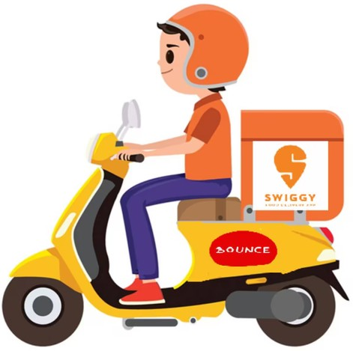
Follow for more Data Analytics Insights

